Slide 1
insertion Sort

Slide 2
Insertion Sort
Explanation of Insertion Sort
Visualization of Insertion Sort
Implementation of Insertion Sort

Slide 3
Insertion Sort
The insertion sort always maintains a sorted sublist in the lower positions of the list.
Each new item is then “inserted” back into the previous sublist such that the sorted sublist is one item larger.

Slide 4
Insertion Sort
We begin by assuming that a list with one item (position 0) is already sorted.
On each pass, one for each item 1 through n−1, the current item is checked against those in the already sorted sublist.
As we look back into the already sorted sublist, we shift those items that are greater to the right.
When we reach a smaller item or the end of the sublist, the current item can be inserted.

Slide 5
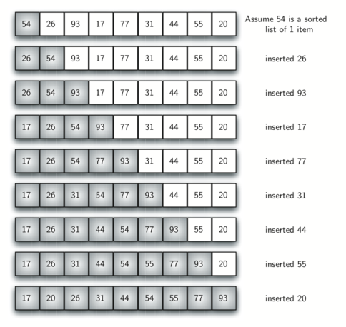

Slide 6
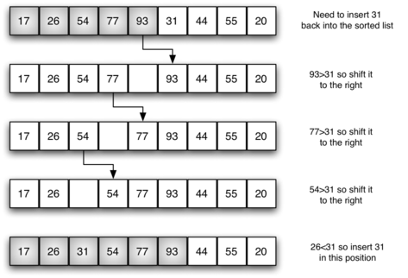

Slide 7
Visualizations
Let’s take a look at some visualizations!

